Slide 1





Slide 2


CYBERSECURITY
AWARENESS TRAINING
2021

Slide 3


TODAY’S PRESENTER:
Chris Montgomery
Director of Sales
Notes:
Thank you to everyone for joining our webinar. Today is part 2 in our multipart series on the components of Microsoft 365.
Before we get started, I wanted to introduce our team today. First, my name is Chris Montgomery and I’m the Director of Sales for ThrottleNet.
With me I have AJ Rodgers tracking our Q&A board for any questions and George Rosenthal – ThrottleNet’s President – orchestrating our webinar today.
In addition and performing our demonstration today, we have Chris Gloeckner. I forgot to tell everyone what Chris does at ThrottleNet during last weeks webinar and may have left some thinking he’s a full-time helicopter pilot as opposed to what he really is - our Service Manager – probably one of the most important roles in the company.
I also want to mention that at anytime you can view this webinar by going to www.throttlenet.com/webinars.
And for those that missed it, last weeks webinar – our first – was on OneDrive which can also be found at throttlenet.com/webinars.
Now that you’ve met the team, what are we covering today?

Slide 4


AGENDA
The State of Cybersecurity 2021
The Most Common Types of Cyber Attacks
Security Definitions
General Best Practices
How to Safely Browse the Internet
How to Securely Use Email

Slide 5

THE STATE OF
CYBERSECURITY

Slide 6
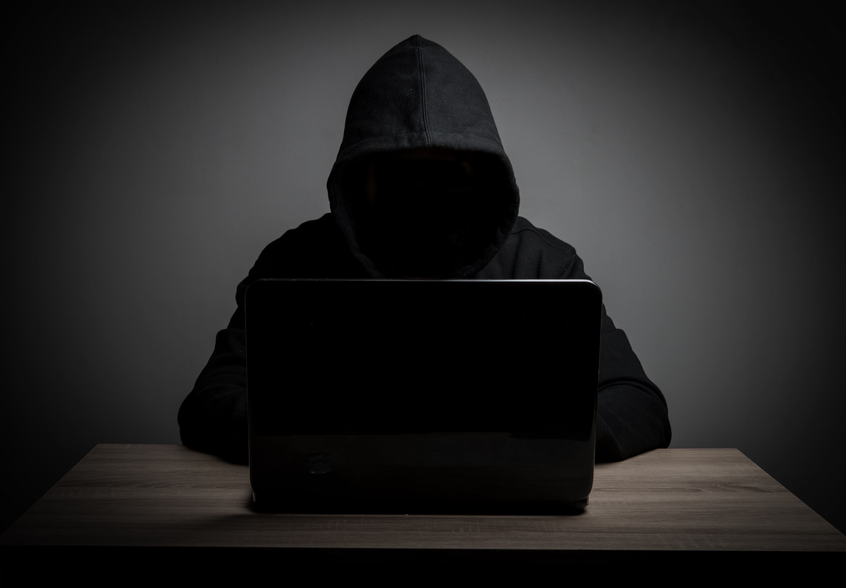

In 2020 A New Ransomware Attack Occurred Every
14 Seconds
(2021, it will be every 11 seconds)
Source: Fiserve

Slide 7
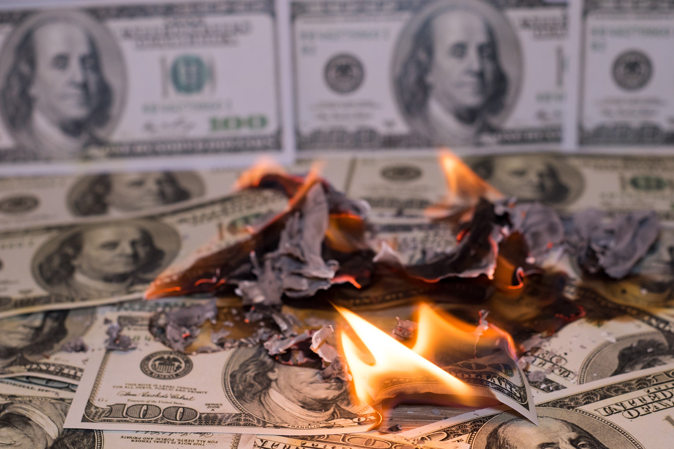
in Victim Losses Reported
$10.2 BILLION
The Internet Crime Complaint Center (IC3) routinely analyzes complaints submitted by victims of internet crimes. It emphasizes the IC3’s efforts in monitoring trending scams such as Business Email Compromise (BEC), Ransomware, Tech Support Fraud, and Extortion.
Corporate Data Breach $53,398,278 | Personal Data Breach $120,102,521 | Credit Card Fraud $111,491,163
Business Email Account $1,776,549,688 | Identity Theft $160,305,789 | Investment Fraud $222,186,195
Source: https://pdf.ic3.gov/2019_IC3Report.pdf

Slide 8

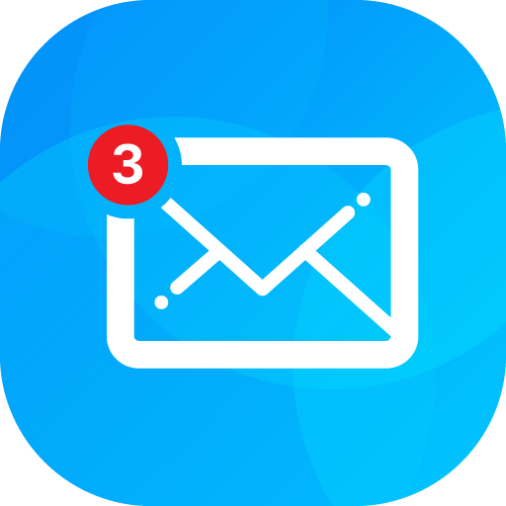
compromise
BUSINESS EMAIL
Two common financial losses related to BEC:
Fraudulent transfers of money
Obtaining personally identifiable information of staff to use in future attacks
Source: https://pdf.ic3.gov/2019_IC3Report.pdf

Slide 9





Industries Consistently Under Attack
Finance
Healthcare
Construction
Legal
Manufacturing

Slide 10


Why Don’t We Hear About SMB Cyber Attacks?
Not Newsworthy
Extremely Embarrassing to admit
Horrible PR: Do you want clients to know?
Legal Ramifications: Many incidents go unreported

Slide 11




SMB Challenges
With Cybersecurity
They believe their IT team and basic firewall, Anti-Virus has them covered
They want flexibility to use free or inexpensive, and unrestricted resources
Blind Trust
Inconvenient
They expect personal devices and lower % of expense budget to cover basic security needs.
Expensive
They don’t believe it will happen to them; it’s just the big guys that get targeted
Too Small

Slide 12
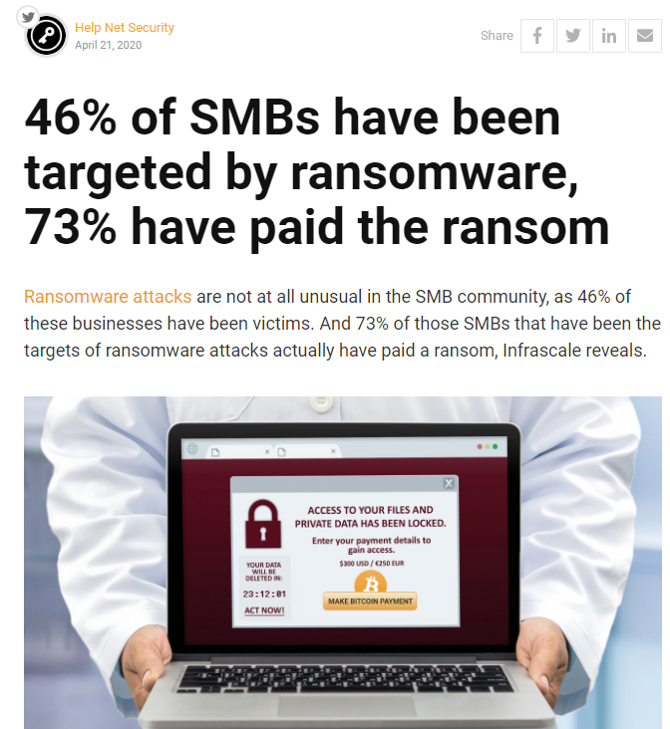
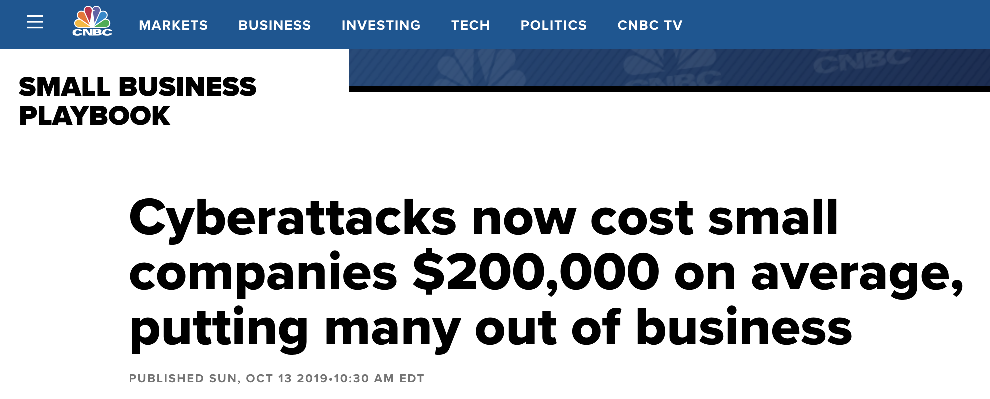
Source: https://www.cnbc.com/2019/10/13/cyberattacks-cost-small-companies-200k-putting-many-out-of-business.html
Source: https://www.helpnetsecurity.com/2020/04/21/paying-ransom/?web_view=true

Slide 13

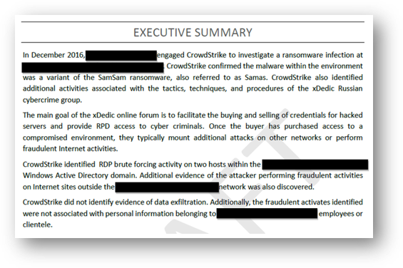
Law Firm / Professional Services Firm
A Real-World Example
5,000,000 Encrypted Files
Paid $25,360 Ransom
Backups Were Corrupted
Down for Two Weeks
39 Hours to Restore per TB

Slide 14
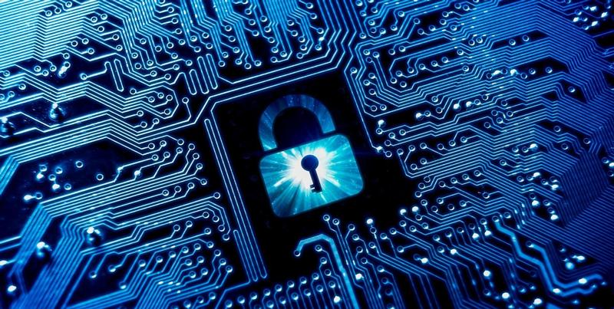
SECURITY DEFINITIONS

Slide 15
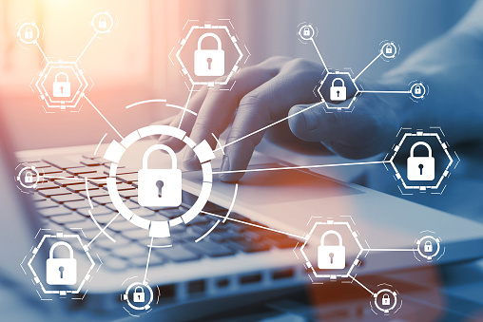
ENCRYPTION
Coding/scrambling the exchanged data to keep it secure from eavesdroppers. That means that while you are browsing a website, nobody can "listen" to your conversations, track your activities across multiple pages, or steal information.

Slide 16

DATA INTEGRITY
Data cannot be modified or corrupted during transfer, intentionally or otherwise, without being detected.

Slide 17

AUTHENTICATION
Proves that you communicate with the intended website. It protects against man-in-the-middle attacks and builds user trust, which translates into other business benefits.

Slide 18
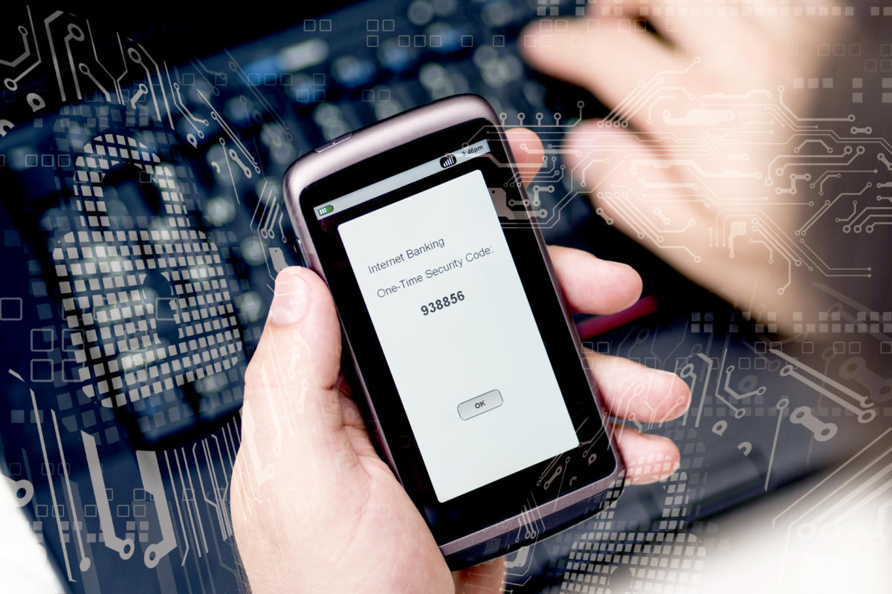
TWO-FACTOR AUTHENTICATION
TWO-FACTOR AUTHENTICATION will help you to maintain your security online by requiring a second method of authentication like a code sent to your phone or from an authentication app to complete login.
Notes:
Something you know – password, pin, code word, secret handshake
Something you have – key, smart phone (text, authy, etc), smart card, RSA token – tell story how we use MFA at TN, and what you personally use to MFA (authy, etc). It’s a common misconception that you would have to MFA every time you login. For example, MS365 will save your MFA for 30 days. For financial websites, that you aren’t using everyday, it’s important to MFA every time you login.
Something you are – includes any part of the human body. Retina scan, fingerprint, facial recognition

Slide 19
COMMON TYPES OF CYBER ATTACKS

Slide 20

DENIAL OF SERVICE (DDoS) ATTACKS
A denial-of-service attack overwhelms a system’s resources so that it cannot respond to service requests.
9VcH6DvTqj
Notes:
A DDoS attack is also an attack on system’s resources, but it is launched from a large number of other host machines that are infected by malicious software controlled by the attacker.

Slide 21

MAN-IN-THE MIDDLE (MitM) ATTACK
A MitM attack occurs when a hacker inserts itself between the communications of a client and a server.
9VcH6DvTqj

Slide 22
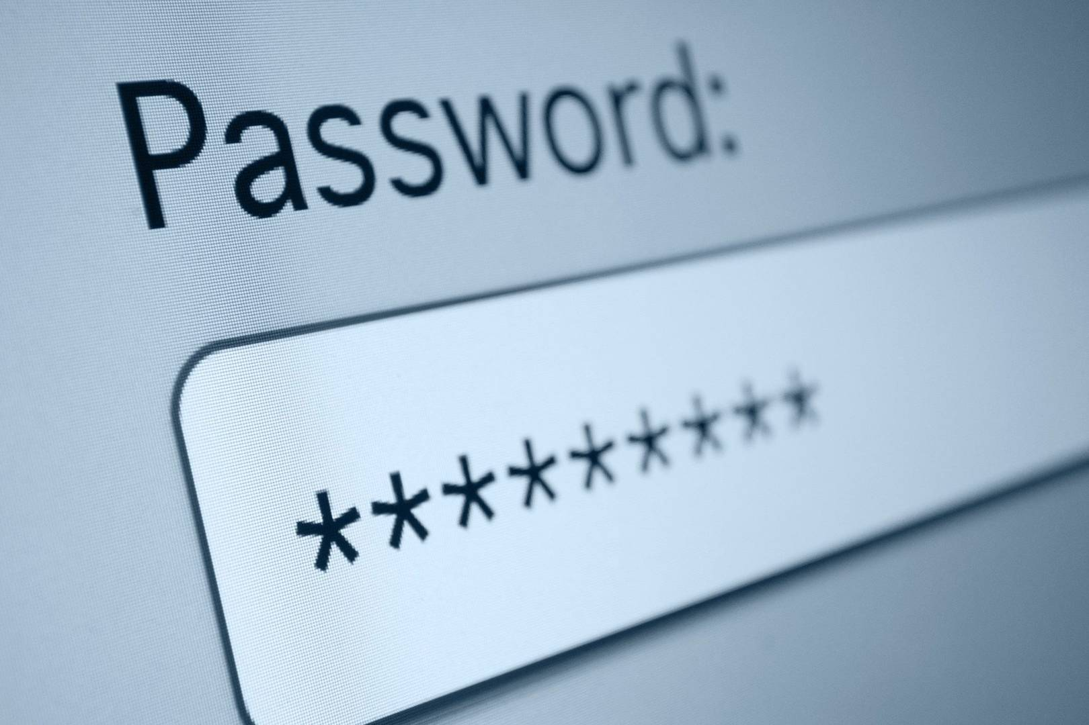
PASSWORD ATTACK
BRUTE-FORCE password guessing means using a random approach by trying different passwords and hoping that one work Some logic can be applied by trying passwords related to the person’s name, job title, hobbies or similar items.
DICTIONARY ATTACK a dictionary of common passwords is used to attempt to gain access to a user’s computer and network.
Notes:
Dictionary Attack continued - One approach is to copy an encrypted file that contains the passwords, apply the same encryption to a dictionary of commonly used passwords, and compare the results.

Slide 23

EAVESDROPPING ATTACK
Eavesdropping attacks occur through the interception of network traffic. By eavesdropping, an attacker can obtain passwords, credit card numbers and other confidential information that a user might be sending over the network. Eavesdropping can be passive or active:
PASSIVE EAVESDROPPING— A hacker detects the information by listening to the message transmission in the network.
ACTIVE EAVESDROPPING— A hacker actively grabs the information by disguising himself as friendly unit and by sending queries to transmitters. This is called probing, scanning or tampering.

Slide 24
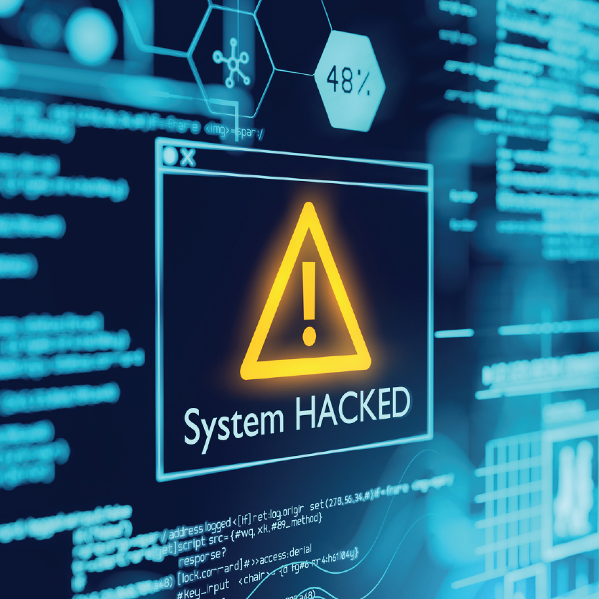
DRIVE-BY ATTACK
DRIVE-BY DOWNLOAD attacks are a common method of spreading malware. Hackers look for insecure websites and plant a malicious script into HTTP or PHP code on one of the pages. This script might install malware directly onto the computer of someone who visits the site, or it might re-direct the victim to a site controlled by the hackers.
Notes:
Unlike many other types of cyber security attacks, a drive-by doesn’t rely on a user to do anything to actively enable the attack — you don’t have to click a download button or open a malicious email attachment to become infected. A drive-by download can take advantage of an app, operating system or web browser that contains security flaws due to unsuccessful updates or lack of updates.

Slide 25
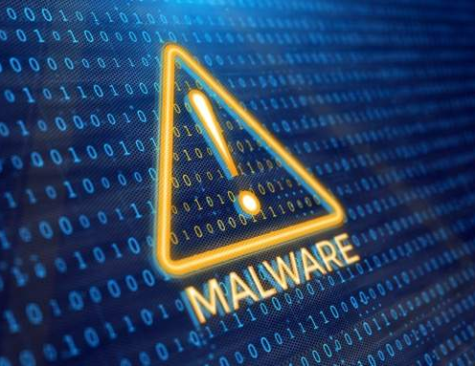
MALWARE ATTACK
MALWARE is malicious software can be described as unwanted software that is installed in your system without your consent. It can attach itself to legitimate code and propagate; it can lurk in useful applications or replicate itself across the Internet.
Notes:
The most well-known type of malware attack is ransomware. Ransomware is a type of malware that blocks access to the victim’s data and threatens to publish or delete it unless a ransom is paid. While some simple computer ransomware can lock the system in a way that is not difficult for a knowledgeable person to reverse, more advanced malware uses a technique called crypto viral extortion, which encrypts the victim’s files in a way that makes them nearly impossible to recover without the decryption key.

Slide 26
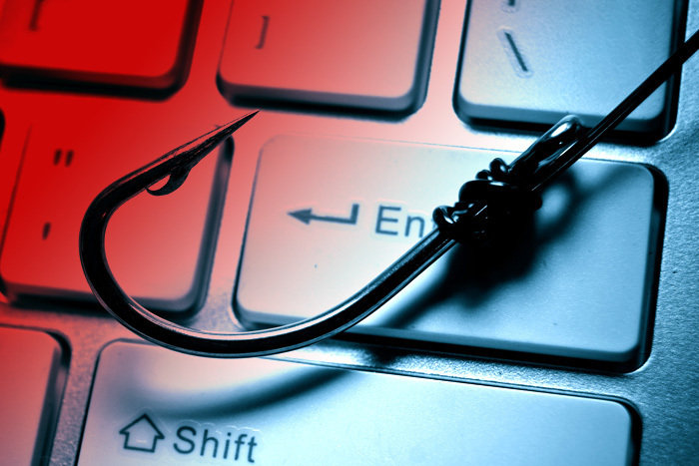
SPEAR PHISHING ATTACK
SPEAR PHISHING is a very targeted type of phishing activity. Attackers take the time to conduct research into targets and create messages that are personal and relevant. Because of this, spear phishing can be very hard to identify and even harder to defend against.
Notes:
One of the simplest ways that a hacker can conduct a spear phishing attack is email spoofing, which is when the information in the “From” section of the email is falsified, making it appear as if it is coming from someone you know, such as your management or your partner company. Another technique that scammers use to add credibility to their story is website cloning — they copy legitimate websites to fool you into entering personally identifiable information (PII) or login credentials.

Slide 27

PHISHING ATTACK
PHISHING ATTACK - is the practice of sending emails that appear to be from trusted sources with the goal of gaining personal information or influencing users to do something. It combines social engineering and technical trickery. It could involve an attachment to an email that loads malware onto your computer. It could also be a link to an illegitimate website that can trick you into downloading malware or handing over your personal information.

Slide 28

HOW TO SAFELY USE
THE INTERNET

Slide 29
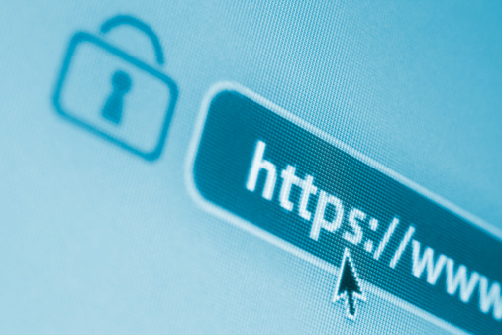
HTTPS keeps your information secure!
Look for ‘HTTPS’ in the web address you’re viewing.
Secure websites will have a padlock icon in the browser’s address bar that can be clicked on for more information regarding that security of that site.
Look for this symbol to ensure that you’re on a secure site.
Notes:
The S stands for secure and means your web browser has a secure connection with the web server. Any time you are entering a username and password on a website, you should ensure that the connection is using https.

Slide 30
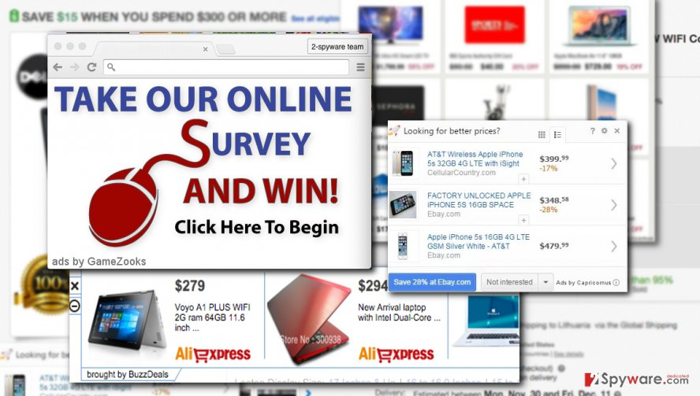
BROWSER ADS
Some advertisements encountered online are nefarious and can be used to compromise your security.
Consider installing an add-on or extension to block web advertising such as uBlock Origin or Adblock Plus.
Notes:
There will be some sites that will need to have the Ad Blocker disabled. The pop-up window will usually walk you through enabling ads for that specific site or page.
Be sure you are only using one of these two programs, and they are installed as a Chrome, Firefox or Edge extension.

Slide 31

VARY PASSWORDS
When you use the same password across many sites it makes it easy for criminals to hack all of your accounts. Use more complex and varied passwords for sites with personal information such as banking sites.

Slide 32

BE CREATIVE WITH PASSWORDS
Tr0ub4dor&3 could take just (3) three days to crack, according to verified security researchers, while CorrectHorseBatteryStaple could take 550 years to crack*
*Nbcnews.com article excerpt
Notes:
Let them know that we practice what we preach.
Give anecdote on a long dumb password you remember (jaggedhorsepoundbutter)
Recommend a passphrase – song lyric, movie quote, short statement
Use proper punctuation – I love my new Mustang!

Slide 33
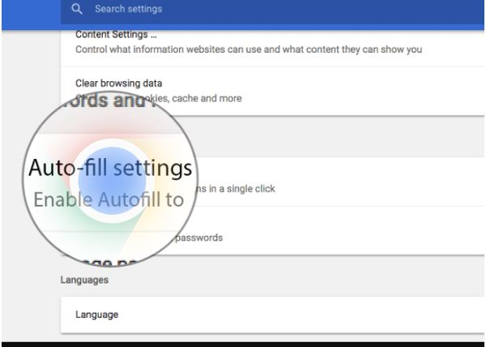
DON’T USE AUTOFILL
If needed, use a third-party application like LastPass to help you remember passwords.
AutoFill / Auto Complete / Remember Me – these can all cache your private data locally on your computer which can make it accessible to anyone that uses that computer.
Notes:
This is Windows specific to browsers. Apple typically uses Key Pass for password storage.
Chrome does need Windows authentication to view saved passwords
LastPass is a password vault. Discuss the benefits of using a password vault.
Explain how you use a password vault and how it benefits you.

Slide 34
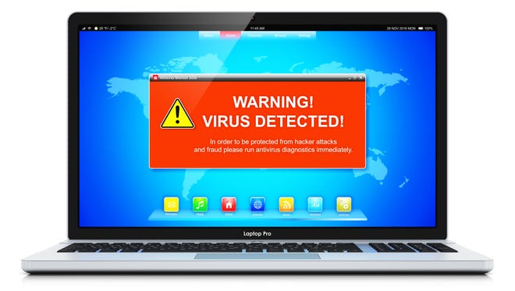
DON’T CLICK IT
Ignore pop ups that claim your computer is infected. Rogue scanners are a category of scam software sometimes referred to as “scareware”. Rogue scanners masquerade as antivirus, antispyware, or other security software, claiming the user's system is infected in order to trick them into paying for a full version. Avoiding infection is easy - don't fall for the bogus claims.

Slide 35
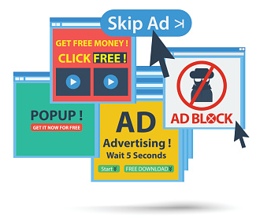
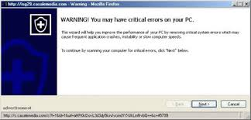
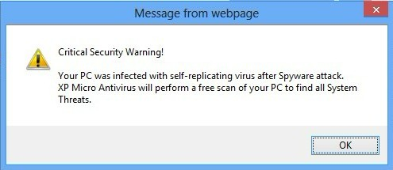
DON’T RUN IT
Beware of windows or pages that prompt you to click a link to run software. Malicious web sites can create prompts that look like messages from your browser or computer. If you see a pop-up you think is risky, go to the company's web site for scans and downloads.

Slide 36

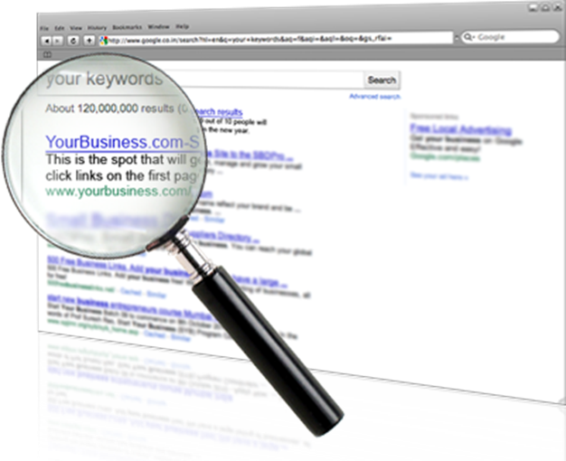
OTHER TIPS
When you use a search engine be very careful of the result you click on. Hackers use legitimate looking topics to trick you into clicking. Scrutinize the URL to ensure you are going to a legitimate web site.
Watch for shortened URLs, and numbers, hyphens or special characters in a URL. Scammers manipulate URLs to trick users. Be wary of URL's posted in Facebook and sent via email. Use a search engine to identify the actual URL.

Slide 37
HOW TO IDENTIFY ATTACKS
WHEN USING EMAIL

Slide 38

What is Social Engineering?
The use of deception to manipulate individuals into divulging confidential or personal information that may be used for fraudulent purposes.
The variation we’re discussing today is Social Engineering in the form of a phishing attack.

Slide 39
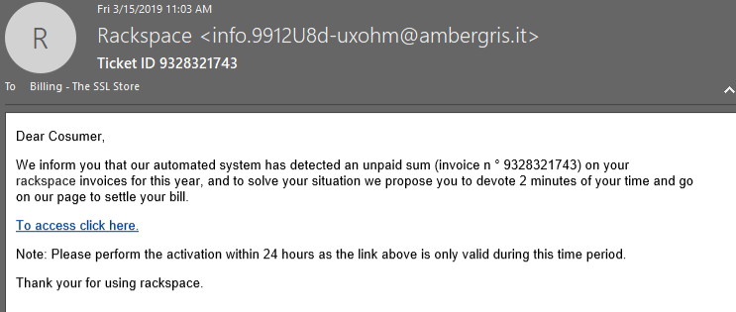
How to identify a Phishing attack:
“From” address is odd
Unprofessional punctuation
Errors in grammar, capitalization & punctuation
Links to an external website
Use of threat to promote immediate action
Notes:
Hovering over a link will display the actual URL in the lower left hand corner.
Make animations for text and arrows – Greg will complete

Slide 40
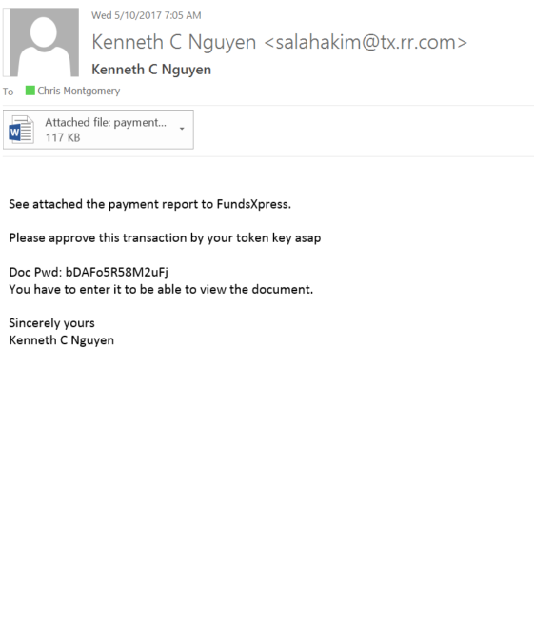
Example #1:
Phishing Attack with
attachment in email Inbox

Slide 41
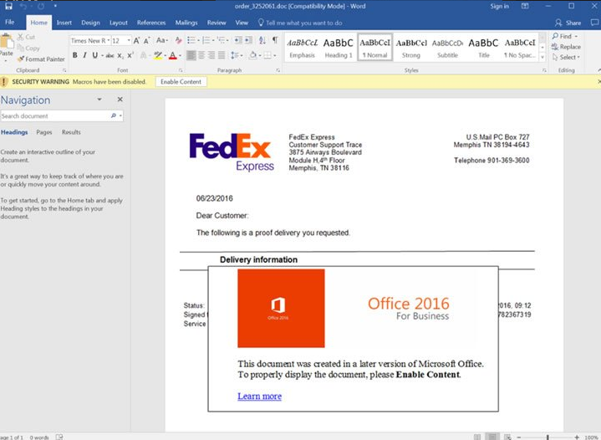
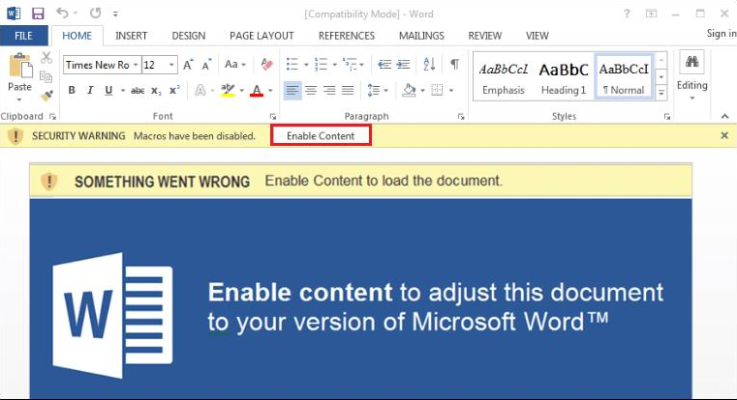
Example #2:
Phishing Attack from trusted source such as FedEx,
Amazon, USPS or UPS
Notes:
Never open an attachment from an untrusted source. Even if you trust the source, but weren’t expecting an email with an attachment, proceed with caution. If it looks suspicious, CALL the sender, don’t just email them back.
IF you do trust the source and open the attachment, you may be prompted to “enable” something or enter your email credentials. Stop there and call ThrottleNet.

Slide 42
Example #3:
Phishing Attack from overseas with
attachment in email Inbox

Slide 43
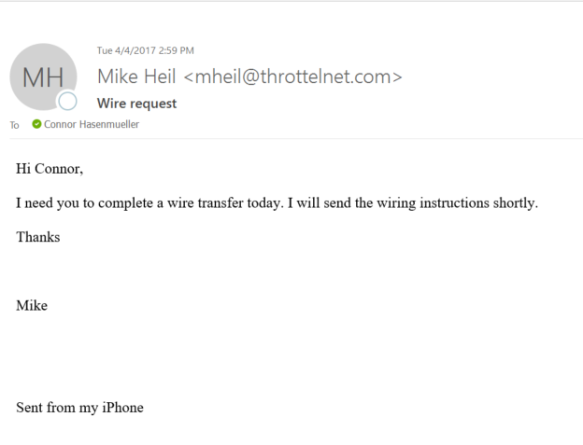
Example #4:
Phishing Attack with a wire transfer or gift card request

Slide 44
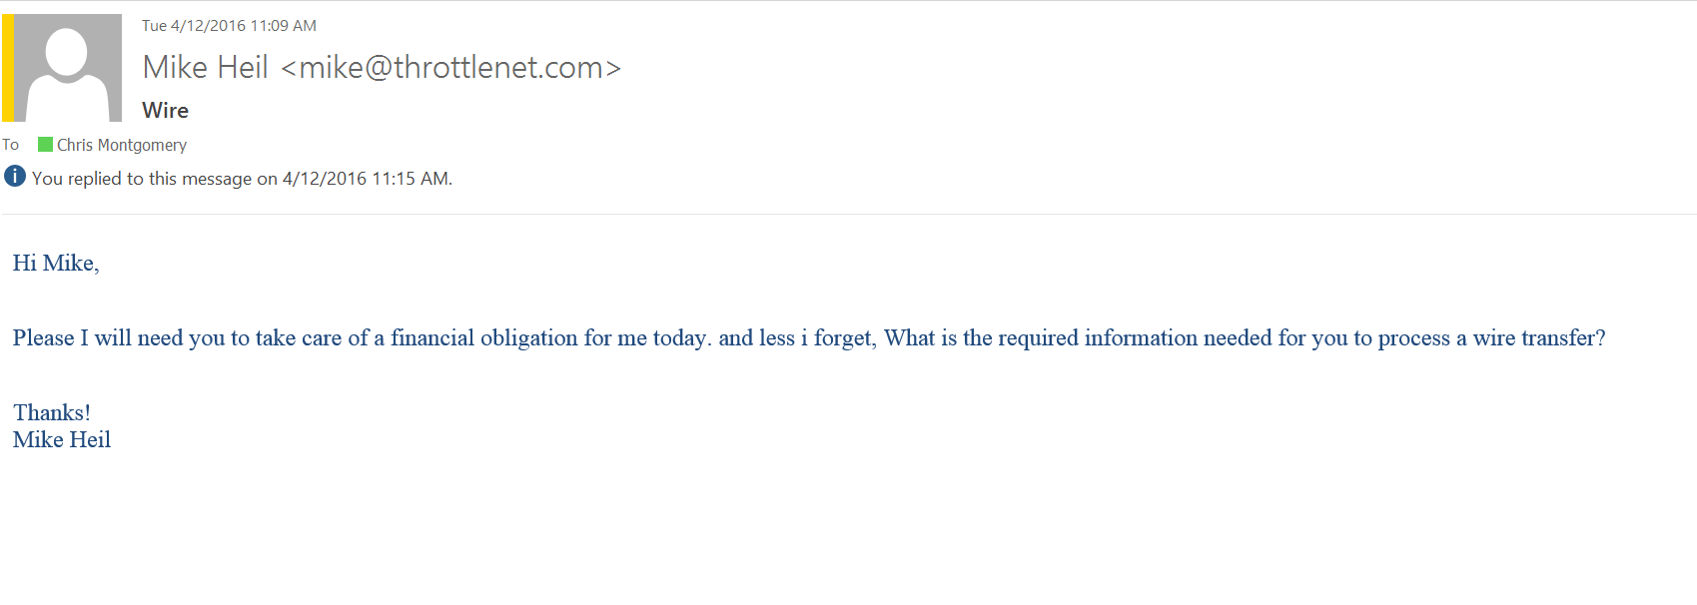
Example #4:
Phishing Attack with
Attempt to gain information

Slide 45
Example #4:
An actual interaction I recently had
with a cyber criminal.

Slide 46

STILL GOING……
They don’t give up and will take whatever you’re willing to give.

Slide 47
STILL GOING……
But this time we didn’t fall for it – and neither will you now that you know what to look for.

Slide 48

IGNORE UNSOLICITED
LINKS IN EMAILS
Malicious or fraudulent links in email and IM are a significant vector for both malware and social engineering attacks
Reading email in plain text can help identify potentially malicious or fraudulent links

Slide 49
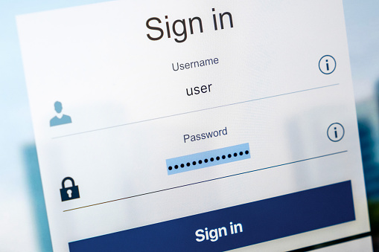
Don’t login to an account from a link received in email, IM or social network
Never, ever login to an account after being directed there via a link received in an email, IM, or social networking message (i.e. Facebook).
If you do follow a link that instructs you to login afterwards, close the page, then open a new page and visit the site using a previously bookmarked or known good link.

Slide 50
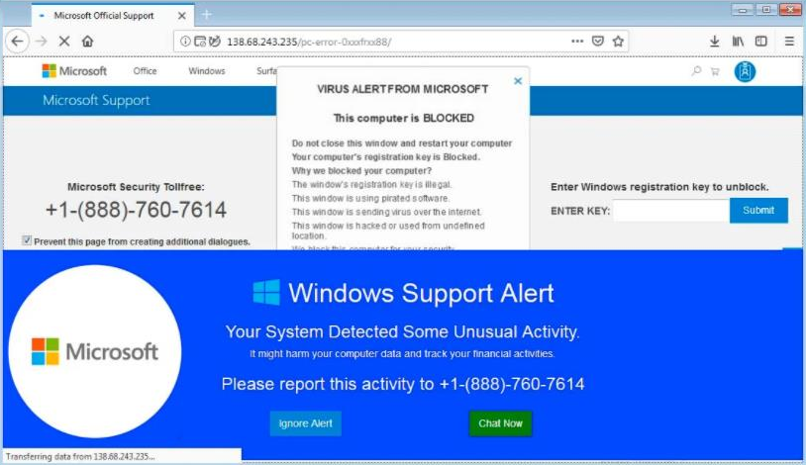
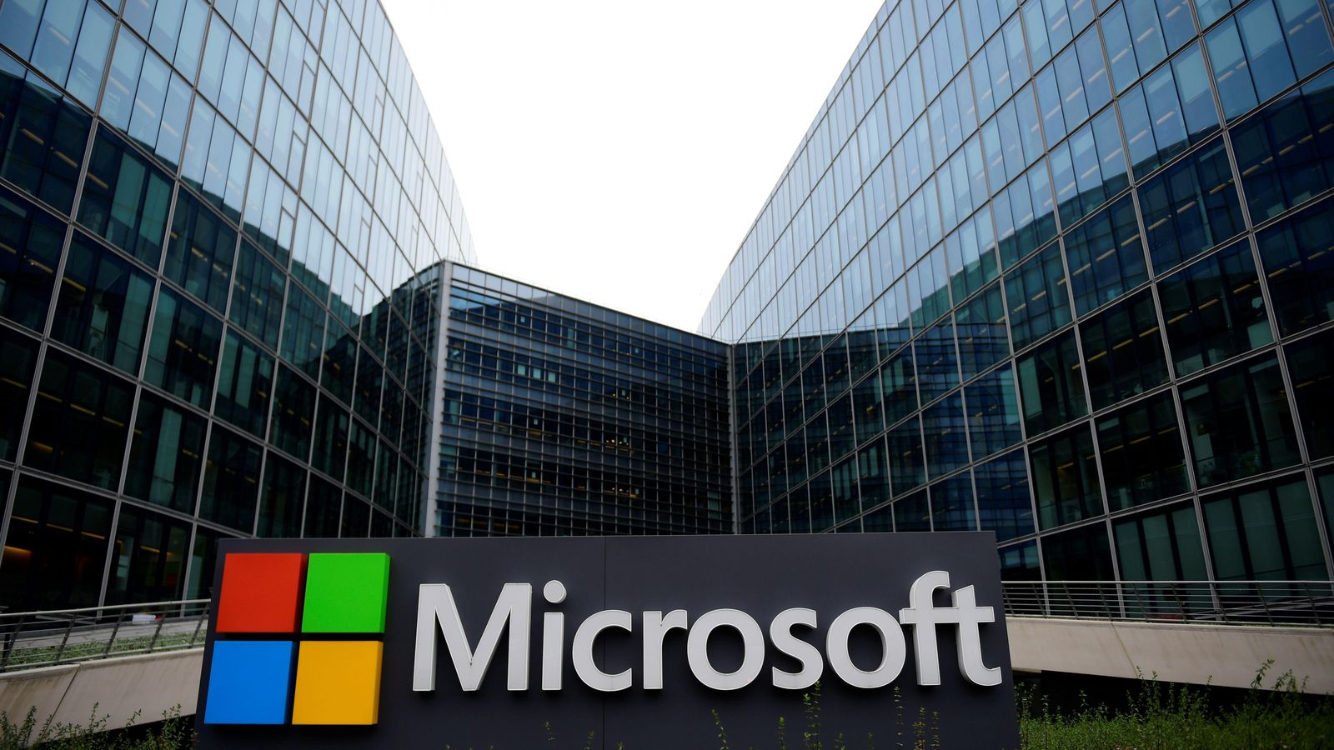
DON’T FALL FOR IT
If a person calls and says he’s from Microsoft Support and wants to connect to your PC, or says your PC is infected or sending email on its own..
HANG UP ON HIM!
Recommendation: Call the helpdesk if in doubt
Notes:
Remind them again that they should call the person back, IF they think it might be legitimate.
Has anyone called Microsoft for support? You need to make a one hour appointment, weeks in advance, and if the issue isn’t resolved in that hour, they will schedule another time slot in a few days. Microsoft IS NOT calling anyone out of pure care and concern.

Slide 51
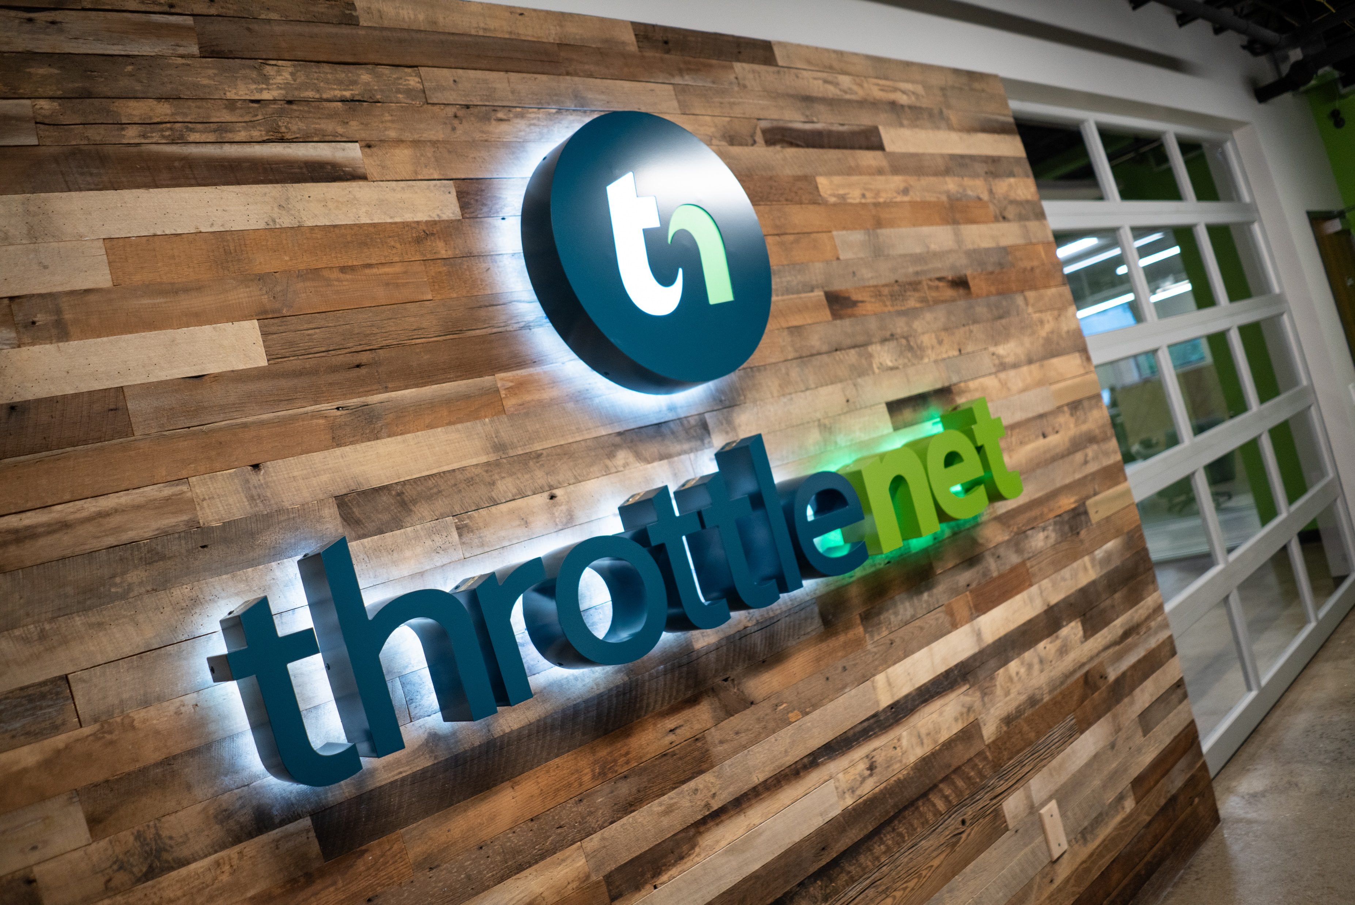
HOW CAN WE
HELP?
866-829-5557
Notes:
If you need anything or are interested in learning more about our services, please check us out online at throttlenet.com or give us a call at 866-829-5557

Slide 52

MANAGED SERVICES
BCDR SOLUTIONS
HOSTING SOLUTIONS
CYBER SECURITY SOLUTIONS

Slide 53

For more information on ThrottleNet visit us online at throttlenet.com or call us toll free at 866-826-5966
Notes:
Finally, we offer a variety of hosting solutions via Microsoft including Office365 and Azure Cloud Hosting.
These solutions – when working in concert – allow you to work from anywhere as long as you have an internet connection. Couple this with a hosted VOIP phone system such as Ring Central and you should be good to go if this ever happens again.

Slide 54

Notes:
Thank you for your time today. Now we’re going to review what questions came in throughout our discussion.
AJ – could you please read the first question for Aaron?

