Slide 1





Slide 2


TODAY’S PRESENTER:
Chris Montgomery
Director of Sales
Notes:
Before we get started, I wanted to introduce our team today. First, my name is Chris Montgomery and I’m the Director of Sales for ThrottleNet. With me I have AJ Rodgers tracking our Q&A board for any questions and George Rosenthal – ThrottleNet’s President – orchestrating our webinar today.
Before we get started, I’d like to set a few guidelines to ensure we work through this material in the most timely manner possible.
First, if you have a question, please feel free to enter it using the Q&A button and enter your question there. In the interest of time, we’ll refrain from answering any questions until the end of the webinar.
You’ll also notice a Chat button as well as a Raise Your Hand button at the bottom, however, we ask that you refrain from using these buttons unless there’s a specific need to do so such as not being able to hear me or not being able to see the slides.
Thank you in advance for your cooperation. Without further ado, let’s get started.

Slide 3

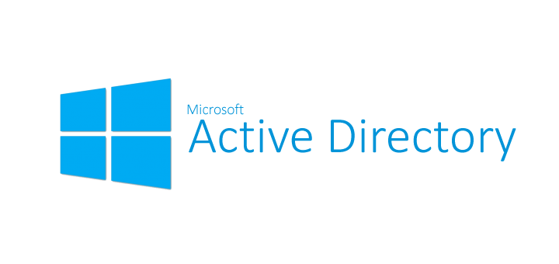


Slide 4

ACTIVE DIRECTORY STATS
AD OUTAGES HAVE A SERIOUS BUSINESS IMPACT. Almost every respondent (97%) said that AD is mission-critical to the business, and 84% said that an AD outage would be significant, severe, or catastrophic.
AD RECOVERY FAILURE RATE IS HIGH. Most respondents (71%) were only somewhat confident, not confident, or unsure about their ability to recover AD to new servers in a timely fashion. Only a tiny portion (3%) said they were “extremely confident.”
Source: Semperis – Recovering Active Directory from Cyber Disasters

Slide 5
ACTIVE DIRECTORY STATS
AD RECOVERY PROCESSES REMAIN LARGELY UNTESTED.
Exactly one-third of organizations (33%) said they have an AD cyber disaster recovery plan but never tested it, while 21% have no plan in place at all. Out of the entire poll, just 15% of respondents said they had tested their AD recovery plan in the last six months.
Organizations expressed many concerns about AD recovery, with the lack of testing being the number one concern. This includes organizations that have not tested AD recovery at all and those who have tried but failed.
Source: Semperis – Recovering Active Directory from Cyber Disasters

Slide 6
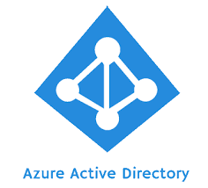
WHAT IS
ACTIVE DIRECTORY?
Active Directory helps you organize your company’s users, computer and more. Your IT admin uses AD to organize your company’s complete hierarchy from which computers belong on which network, to what your profile picture looks like or which users have access to the storage room.

Slide 7
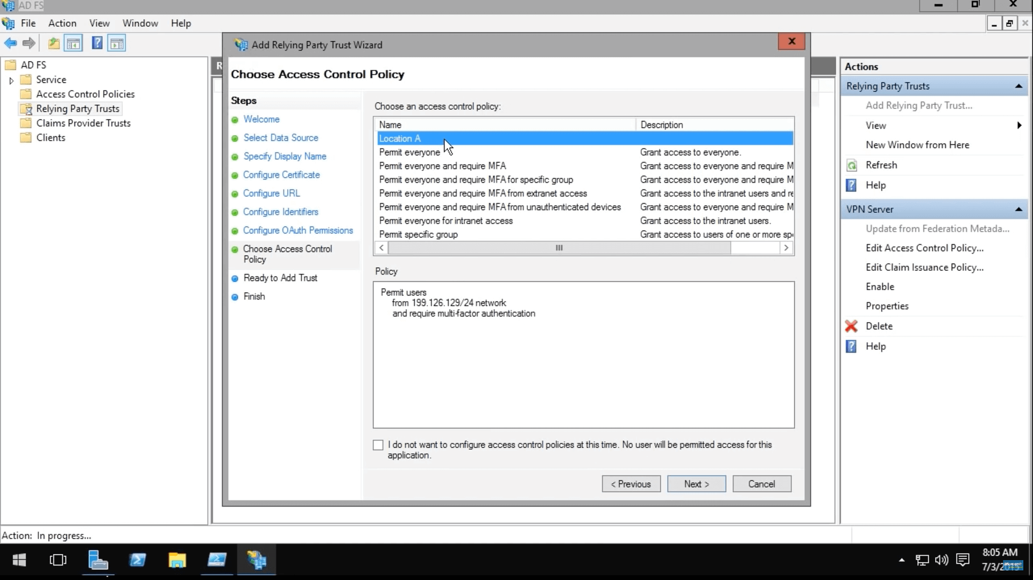
WHAT DOES AN
ACTIVE DIRECTORY
DO?
Active Directory allows network administrators to create and manage domains, users, and objects within a network.
Notes:
For example, an admin can create a group of users and give them specific access privileges to certain directories on the server. As a network grows, Active Directory provides a way to organize a large number of users into logical groups and subgroups, while providing access control at each level.

Slide 8
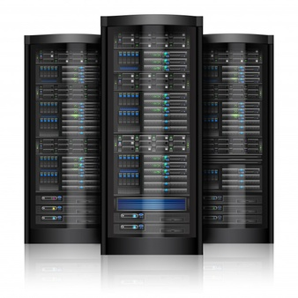
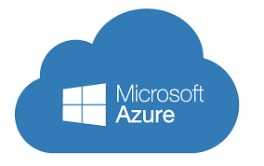
Where is your AD housed or where can it be?
Active Directory services can be housed on a local server or in a hosted environment such as Microsoft Azure. In the case of Azure, this is a standalone offering that doesn’t require a fully hosted server environment.

Slide 9

How does ACTIVE DIRECTORY benefit your business?
ADMINISTRATIVE CONTROL
Since Active Directory grants control of all machines on a network to the administrator, that person can oversee anything that happens on the domain.
This makes it easier to implement specific settings and grant certain rights and privileges to users on the network.
CENTRAL STORAGE
Active Directory domains also provide a centralized storage repository for users’ files. By saving files to the central server, other users on the domain can access them if necessary.

Slide 10
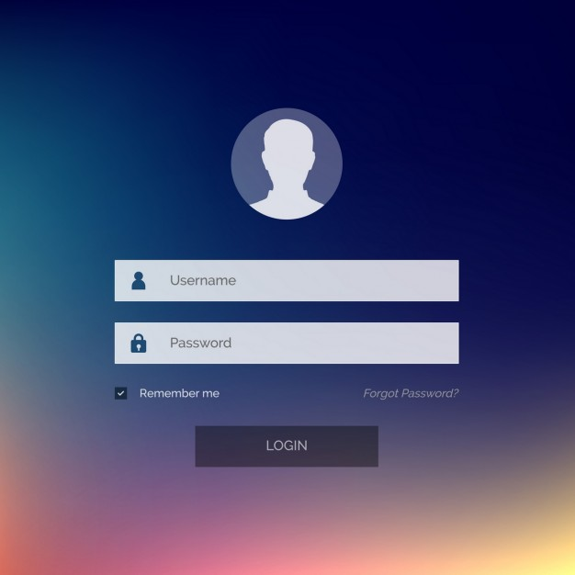
BETTER BACKUPS
Without a central storage domain, users are only able to save their files to their local drives. If a user’s machine is infiltrated by a cyberattack, all of the files on that machine may become inaccessible. However, if they were saved to a central storage location, it would be much easier to recover them.
EASY LOGINS
Once Active Directory is in place, logging into your machine becomes easier. Essentially, when you log into a machine on the network, the machine and network communicate back and forth. The network will verify the password and automatically grant rights and privileges to the user, such as logging into Outlook

Slide 11

IMPROVED SECURITY
Since the network administrator has the ability to control whatever happens on the domain, they’re able to implement new security measures when necessary. This includes installing a new antivirus software onto each machine or making certain sensitive documents inaccessible so they don’t fall into the wrong hands.
CUT COSTS
All of the above benefits of Active Directory streamline IT operations in a way that drastically reduces IT costs.
Since Active Directory is easier to scale up or down than it is to install in the first place, it’s best to implement it as soon as possible. This way, if your business grows, all you must do is add a new machine to the network.

Slide 12

What are the SECURITY benefits of ACTIVE DIRECTORY?
Active Directory provides a single point from which administrators can manage and secure network resources and their associated security objects. An organization can administer Active Directory based on an organizational model, a business model, or the types of functions being administered.
Notes:
Active Directory provides a single point of management for network resources. Active Directory uses a single sign-on to allow access to network resources located on any server within the domain.
The user is identified and authenticated by Active Directory once. After this process is complete, the user signs on once to access the network resources that are authorized for, according to his or her assigned roles and privileges within Active Directory.

Slide 13

HOW ARE CYBERCRIMINALS USING
ACTIVE DIRECTORY?
Cybercriminals today are targeting Active Directory (AD), performing reconnaissance to discover users, servers and computers in an enterprise network and then move laterally to carry out multi-stage attacks to gain access and abuse organization resources and data.
Notes:
Historically, network and physical infrastructure layers have received all the security attention and Active Directory security has lagged. The access we grant our users are the same credentials that are being abused, stolen, and exploited either with purpose or absent mindedness.

Slide 14

Threats to the Active Directory Systems?
DEFAULT SECURITY SETTINGS
AD has a set of predetermined, default security settings created by Microsoft. These security settings may not be ideal for your organization's needs. Additionally, these default security settings are well-understood by hackers, who will attempt to exploit gaps and vulnerabilities.
INAPPROPRIATE ADMINISTRATIVE USERS AND PRIVILEGED ACCESS:
Domain user accounts and other administrative users may have full, privileged access to AD. Most employees, even those in IT, do not need high-level or superuser priveldges.

Slide 15

INAPPROPRIATE OR BROAD ACCESS FOR ROLES AND EMPLOYEES:
AD allows administrators to grant access to specific applications and data based on employee roles. Roles are assigned to groups that determine access levels. It’s important to only allow the levels of access individuals and roles need to perform their job functions.
UNCOMPLEX PASSWORDS FOR ADMINISTRATIVE ACCOUNTS:
Brute force attacks on AD services often target passwords. Uncomplicated passwords and easily guessable passwords are most at risk.

Slide 16

UNPATCHED VULNERABILITIES ON AD SERVERS:
Hackers can quickly exploit unpatched applications, OS, and firmware on AD servers, giving them a critical first-foothold within your environment.
LACK OF VISIBILITY AND REPORTING OF UNAUTHORIZED ACCESS ATTEMPTS:
If IT administrators have awareness about unauthorized access attempts, they can more effectively disrupt or prevent such access attempts in the future. Thus, a clear Windows audit trail is vital to identify both legitimate and malicious access attempts, and to detect any AD changes that have been made.

Slide 17
How do bad actors compromise the ACTIVE DIRECTORY?
INITIAL BREACH TARGETS
Most information security breaches start with the compromise of small pieces of an organization's infrastructure-often one or two systems at a time. These initial events, or entry points into the network, often exploit vulnerabilities that could have been fixed, but weren't. Commonly seen vulnerabilities are:
Gaps in antivirus and antimalware deployments
Incomplete patching
Outdated applications and operating systems
Misconfiguration
Open RDP (Remote Desktop Protocol)

Slide 18
PRIVILEDGE ELEVATION AND PROPOGATION
Specific accounts, servers, and infrastructure components are usually the primary targets of attacks against Active Directory. These accounts are:
Permanently privileged accounts
VIP accounts
"Privilege-Attached" Active Directory accounts
Domain controllers
Other infrastructure services that affect identity, access, and configuration management, such as public key infrastructure (PKI) servers and systems management servers

Slide 19
ATTRACTIVE ACCOUNTS FOR CREDENTIAL THEFT Credential theft attacks are those in which an attacker initially gains privileged access to a computer on a network and then uses freely available tooling to extract credentials from the sessions of other logged-on accounts.
Activities that Increase the Likelihood of Compromise - Because the target of credential theft is usually highly privileged domain accounts and "very important person" (VIP) accounts, it is important for administrators to be conscious of activities that increase the likelihood of a success of a credential-theft attack. These activities are:
Logging on to unsecured computers with privileged accounts
Browsing the Internet with a highly privileged account
Configuring local privileged accounts with the same credentials across systems
Overpopulation and overuse of privileged domain groups
Insufficient management of the security of domain controllers.

Slide 20

How do these compromises impact the ability to do business?
Since Active Directory is central to authorizing users, access, and applications throughout an organization, it is a prime target for attackers.
Notes:
If a cyber attacker is able to access the AD system, they can potentially access all connected user accounts, databases, applications, and all types of information, possibly jeopardizing security for an entire AD forest. Therefore, an Active Security compromise, particularly those that are not caught early, can lead to widespread fallout from which it may be difficult to recover

Slide 21
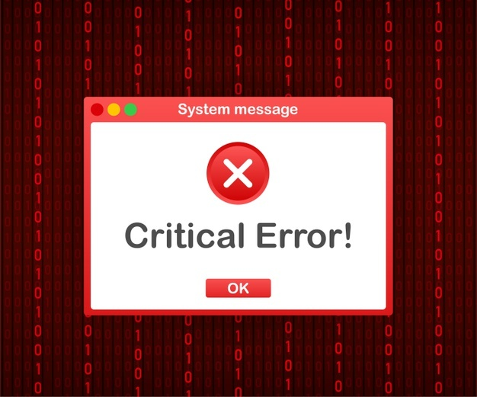
Top 5 CONCERNS for recovering ACTIVE DIRECTORY after a cyberattack
Have not tested AD recovery process
No cyber recovery plan for AD
Backups get encrypted or wiped out
Can’t recover AD quickly
Responsibility for AD recovery hasn’t been defined

Slide 22

What are common best practices to protect the ACTIVE DIRECTORY against attacks?
ENSURE all applications and operating systems are up to date on patches
DEPLOYMENT of AV across all systems and monitor for attempts to remove
CREATION of an incident response plan
ISOLATION of legacy systems and applications that may no longer have new security patches
DISABLE users within AD when they leave the company
IMPLEMENT password refresh policies that ensure if a user isn’t disabled, that their credentials will expire

Slide 23

What should be included in an ACTIVE DIRECTORY recovery plan?
IDENTIFY
the severity of the problem
DETERMINE
how to recover
PERFORM
initial recovery

Slide 24

Why is an image-based backup is key to restoring AD?
An image-based offsite backup takes a snapshot of the entire server including active directory which means you can restore from an attack quickly by simply restoring the image. Ideally, this should include versioning just in case the most recent version has been compromised.

Slide 25
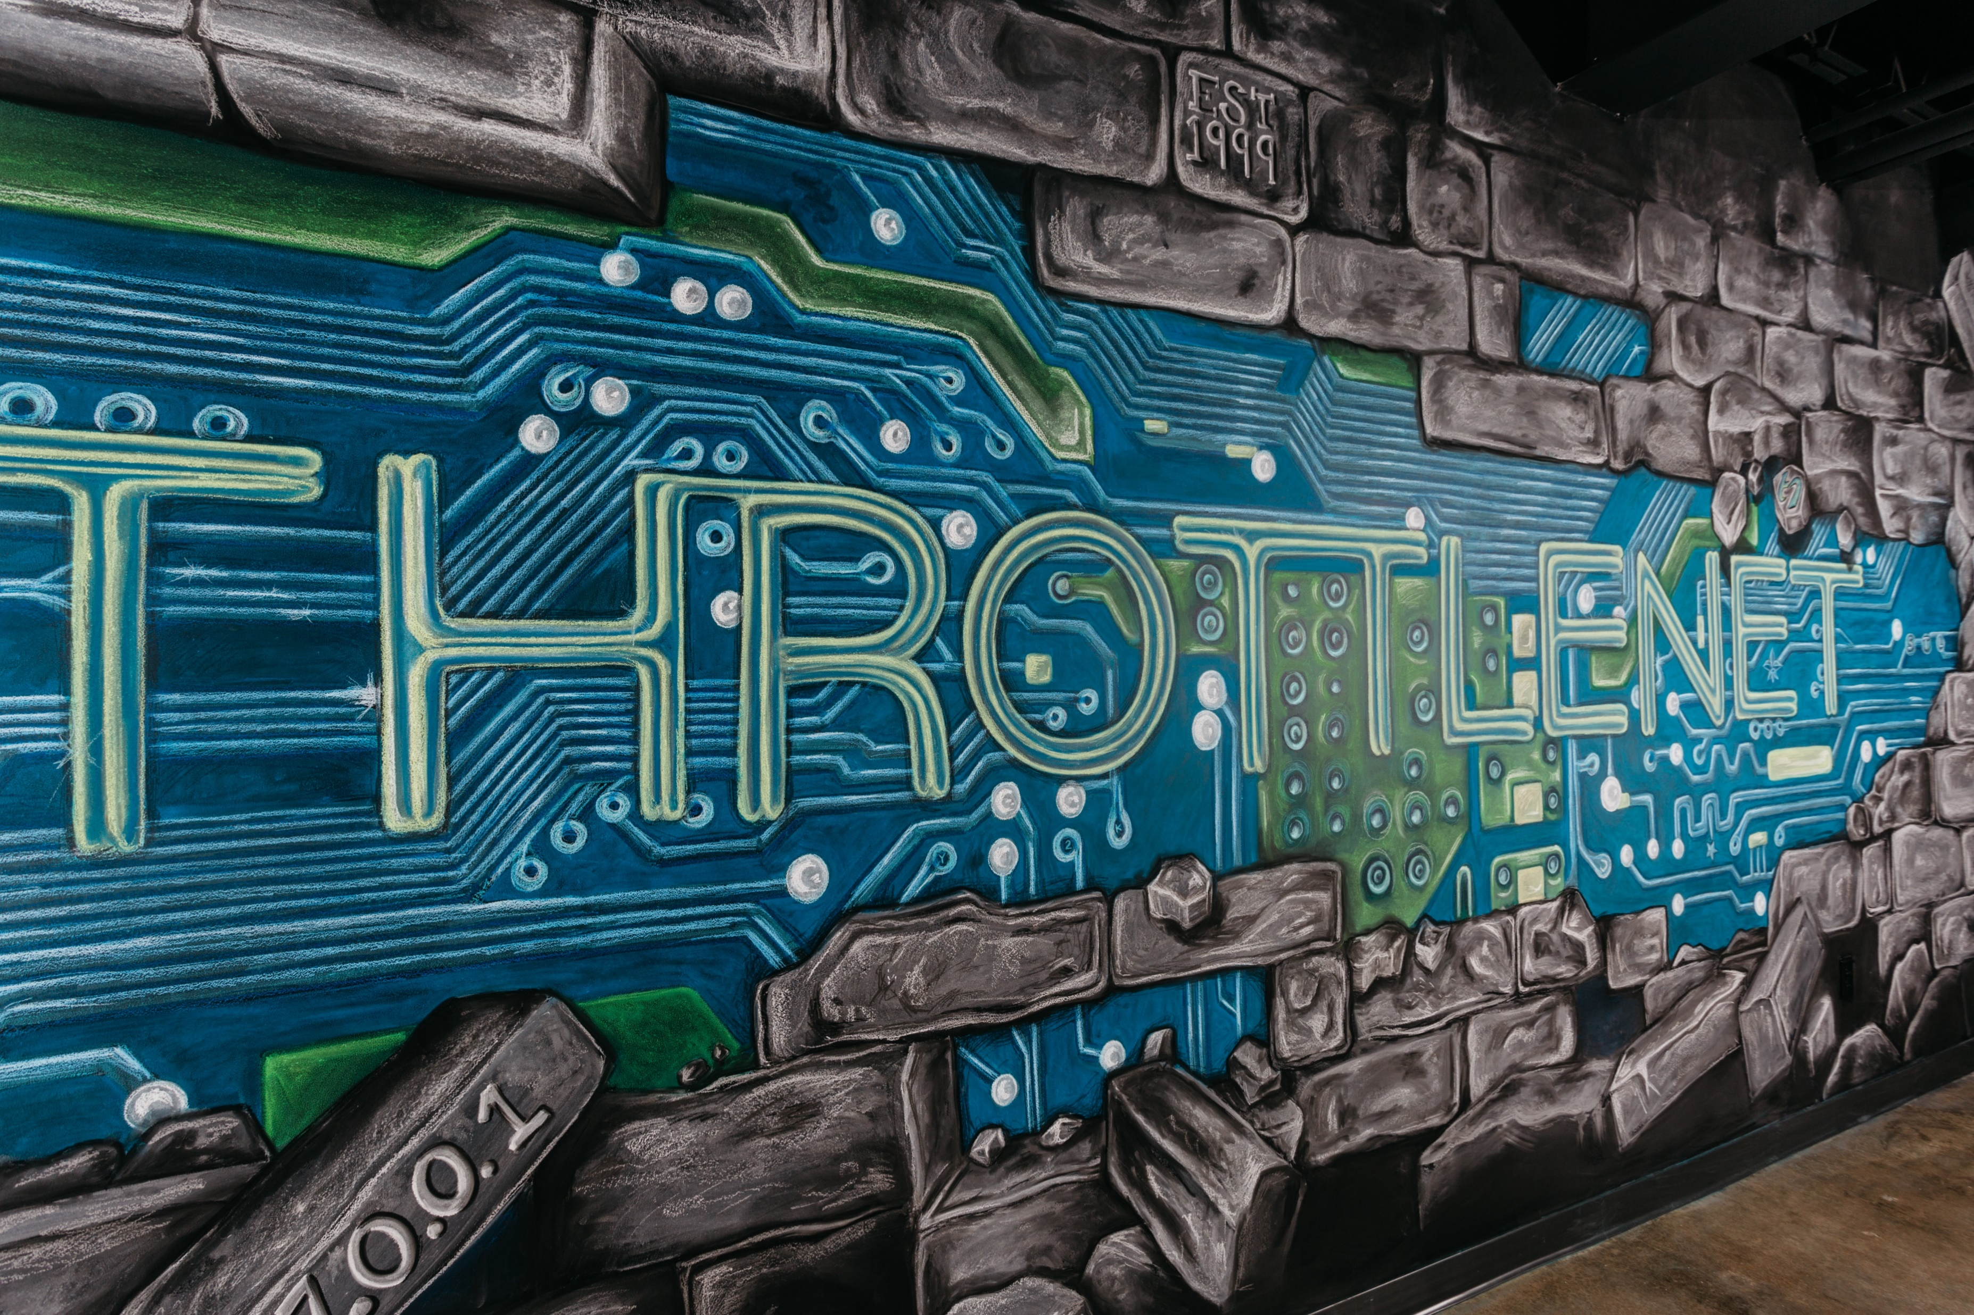
How does TN help protect against and assist in recovery of ACTIVE DIRECTORY
Azure AD Sync
Datto BCDR
Managed Services
Firewalls and Servers
Notes:
Mention tools we have included with MN solution – ransomware detection and mitigation tool, DNS protection, AV solution, patching and updates,

Slide 26
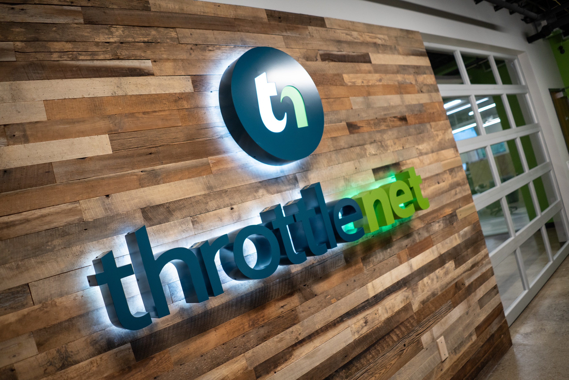
HOW CAN WE
HELP?
866-829-5557
Notes:
If you need anything or are interested in learning more about our services, please check us out online at throttlenet.com or give us a call at 866-829-5557

Slide 27

Notes:
Thank you for your time today. Now we’re going to review what questions came in throughout our discussion.
AJ – could you please read the first question for Aaron?

